Slide 1
Learning to Accelerate TAMP for Human Limb Manipulation
PRPL Lab Meeting - Minseo
Sep 9. 2026
아 발표하기 싫다

Slide 2
Lab Stuff
I’ll take you to real korean restaurants
(not mickey mouse ones) if you go to icra
ICRA (in Seoul ☺)
  September 15: full papers due externally
  September 17: outline of videos due internally (video)
  September 22: videos due externally
When are we doing Samrat goodbye lunch – Josh the lab social chair

Slide 3
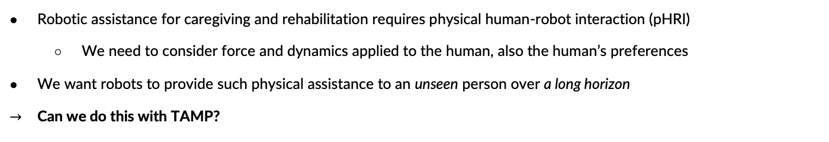
Motivation

Slide 4
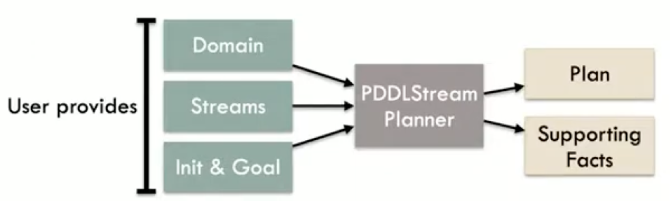
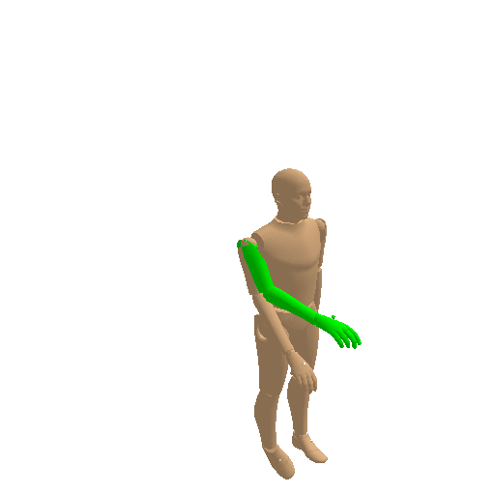
TAMP for Limb Manipulation
Domain
Stream
move-base
plan-base-motion
grasp
sample-grasp
plan-grasp-motion
move-limb
plan-limb-motion
Integrated PDDLStream: goal is to move the limb to desired goal configuration using robot
  Constraints: Range of Motion (RoM) of each human joints, human torque limits, robot joint and torque limits, collision, etc.
PDDLStream works for limb manipulation (maybe?)

Slide 5
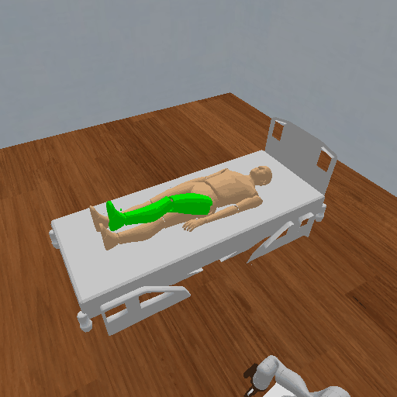
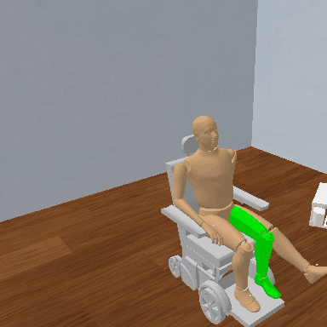
TAMP for Limb Manipulation
Bed
Wheelchair

Slide 6
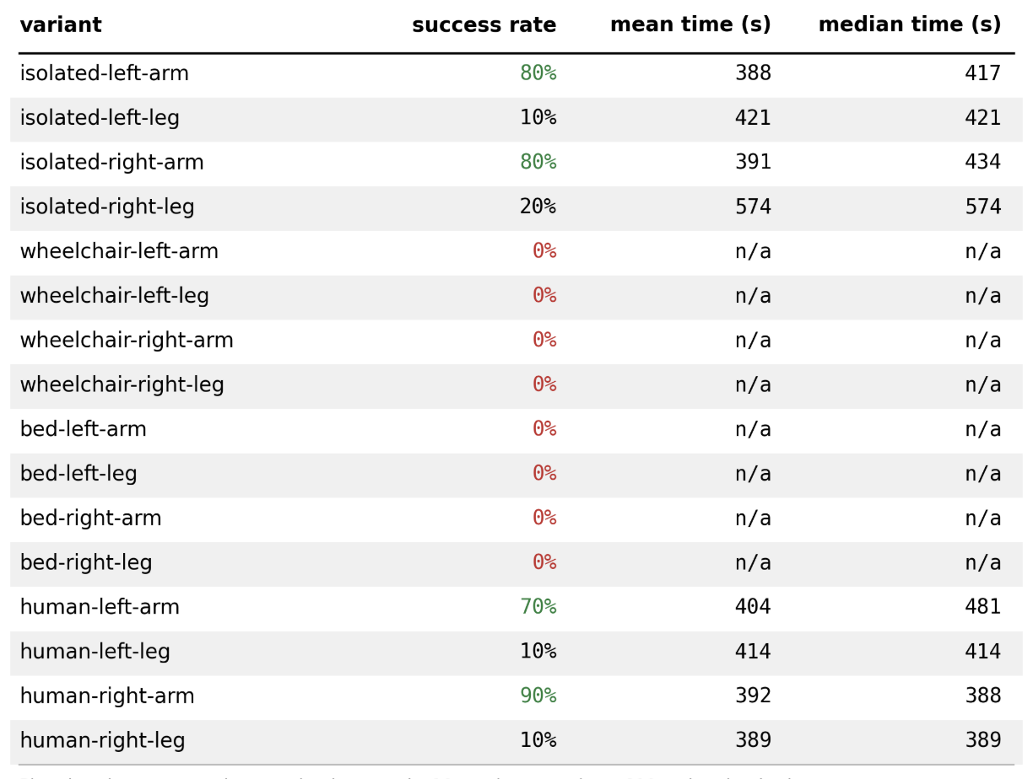
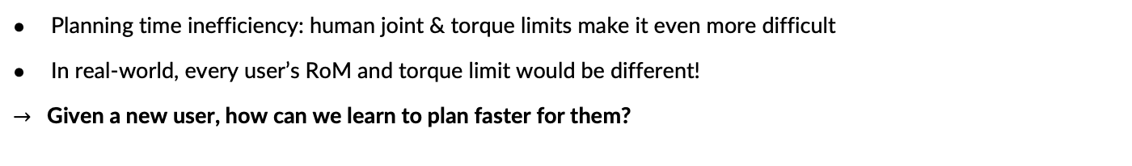
TAMP for Limb Manipulation

Slide 7
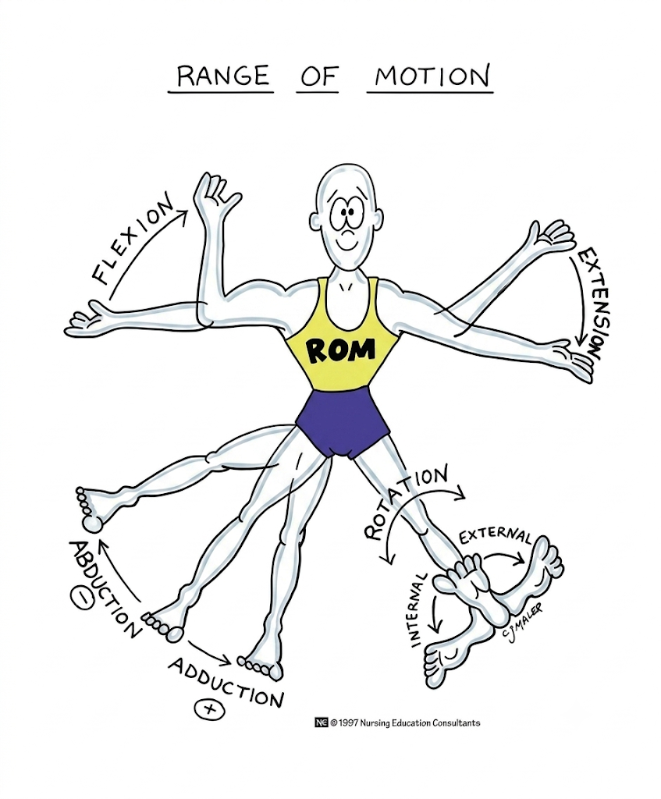

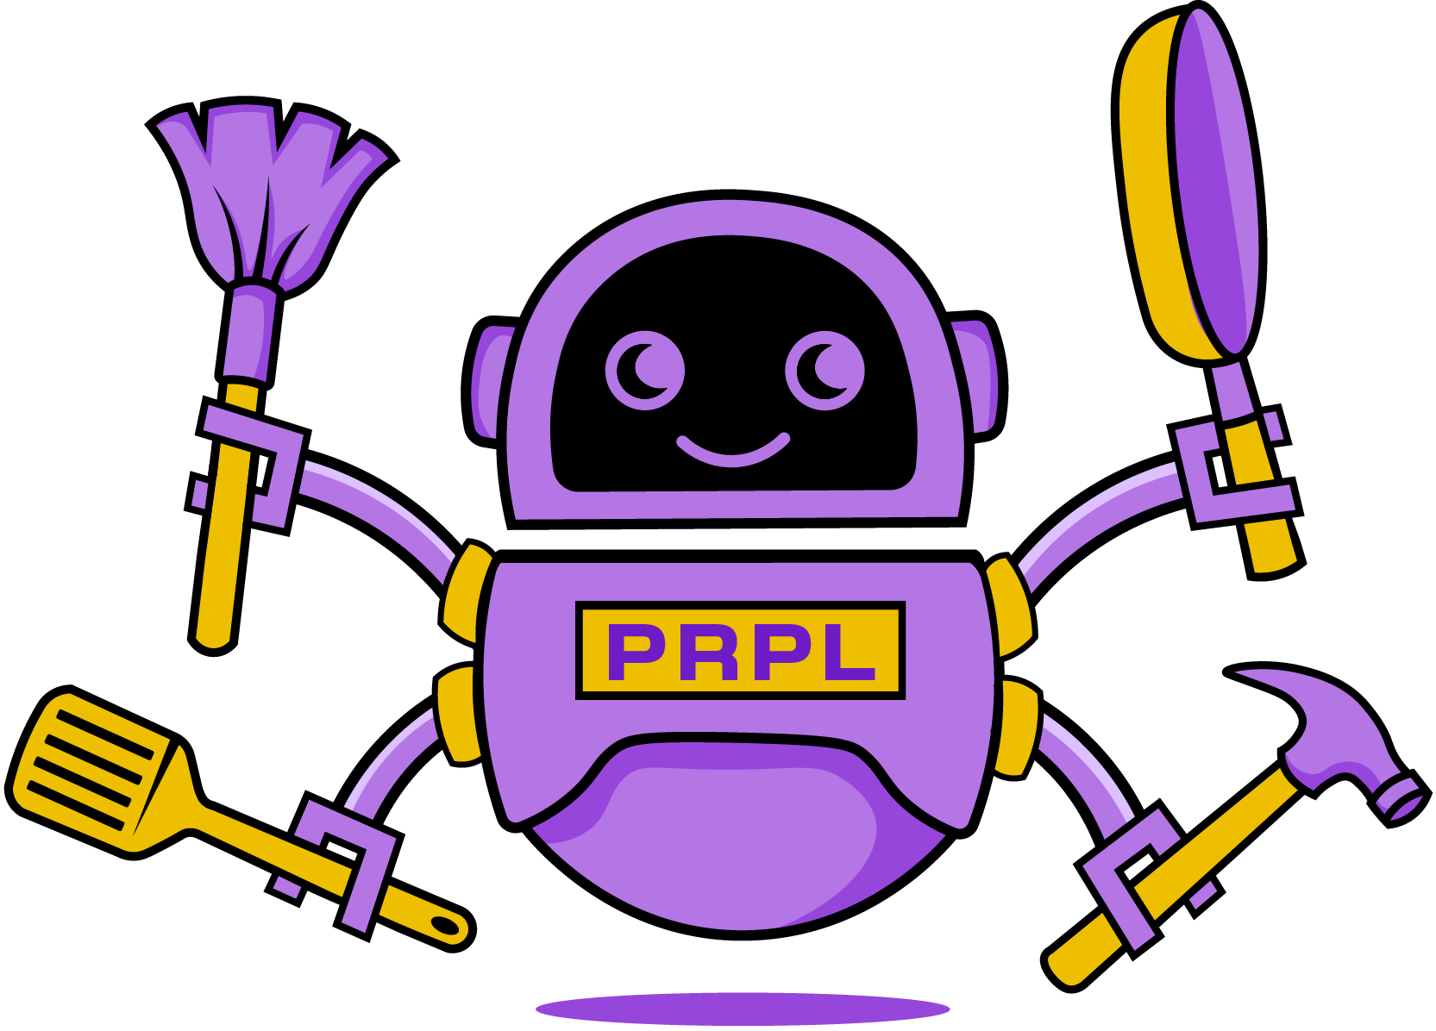
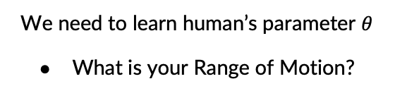
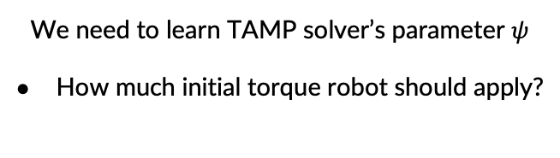
So the Concept is…

Slide 8


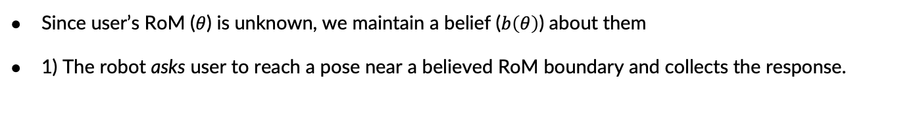
Pipeline
1) Information Gathering
2) Human Model Learning
3) Learn to Plan Faster
4) Planning
& Execution
Queries the user and collect responses

Slide 9



Pipeline
1) Information Gathering
2) Human Model Learning
3) Learn to Plan Faster
4) Planning
& Execution
Queries the user and collect reponses
…
2) The robot updates its belief over the user’s RoM based on whether the person succeeds & how much they can reach

Slide 10




Pipeline
1) Information Gathering
2) Human Model Learning
3) Learn to Plan Faster
4) Planning
& Execution
Queries the user and collect reponses
…
move_base(base_pose)
grasp(grasp)
move_limb(torque_traj)
3) The robot improves its planner during a “sleep phase”: planner solves sampled tasks for this person and uses those solutions to refine the planner’s learnable parameters

Slide 11

Pipeline
1) Information Gathering
2) Human Model Learning
3) Learn to Plan Faster
4) Planning
& Execution
Queries the user and collect responses
…
move_base(base_pose)
grasp(grasp)
move_limb(torque_traj)
4) The robot plans and executes new tasks for that person with the personalized planner

Slide 12
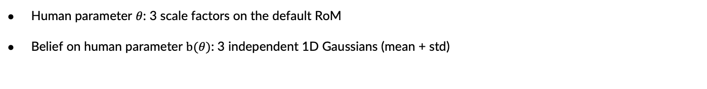
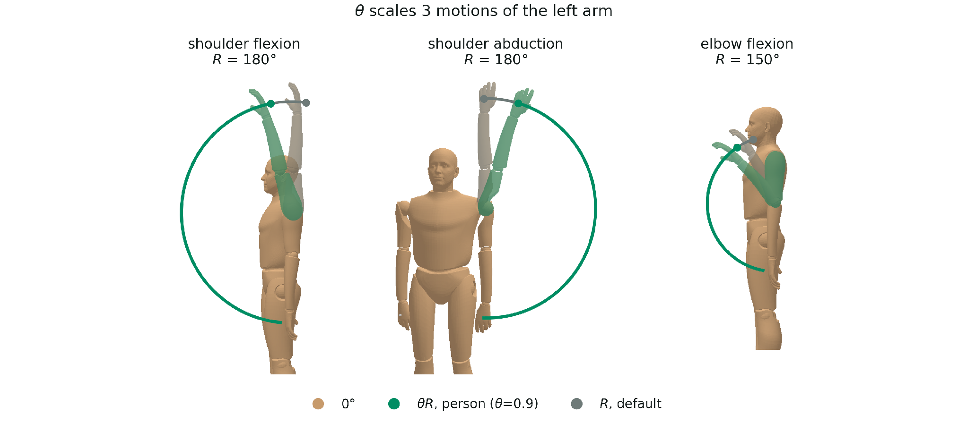
Information Gathering

Slide 13
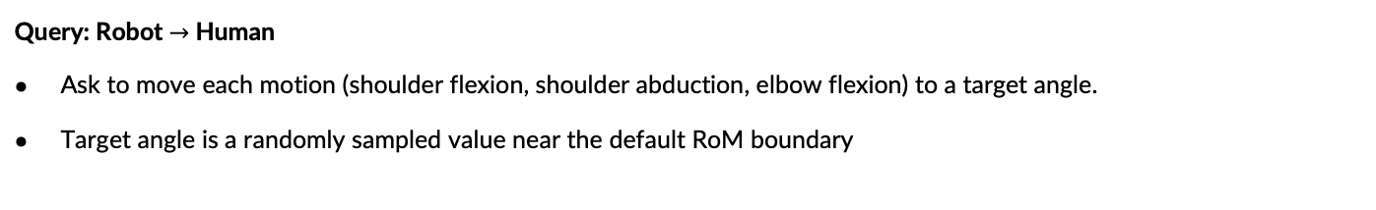
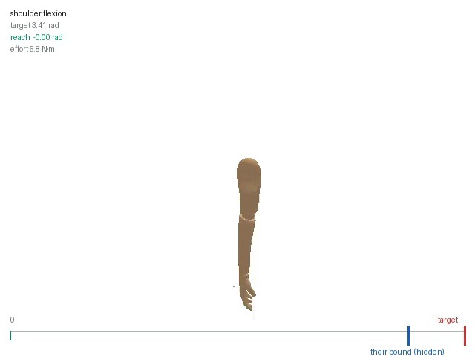
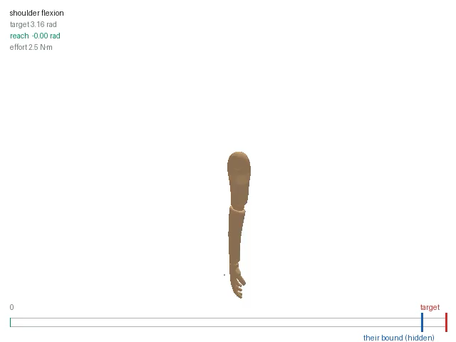
Information Gathering
Human movements are implementd by mass-spring-damper model in sim
Shoulder flexion 1
Shoulder flexion 2

Slide 14
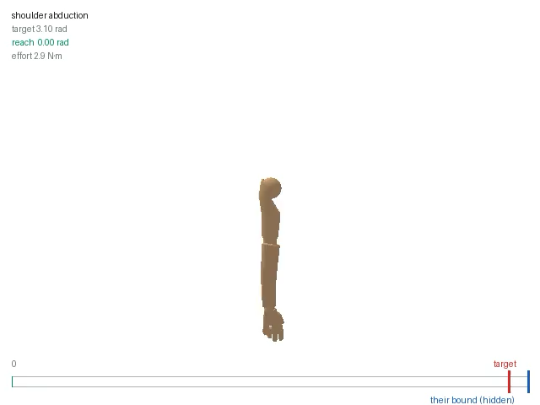
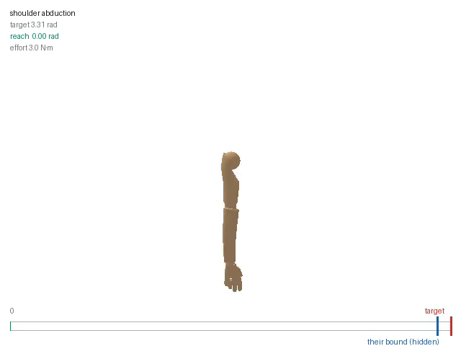
Information Gathering
Shoulder abduction 1
Shoulder abduction 2

Slide 15
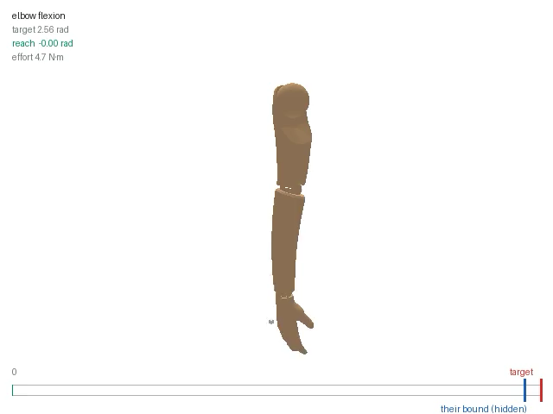
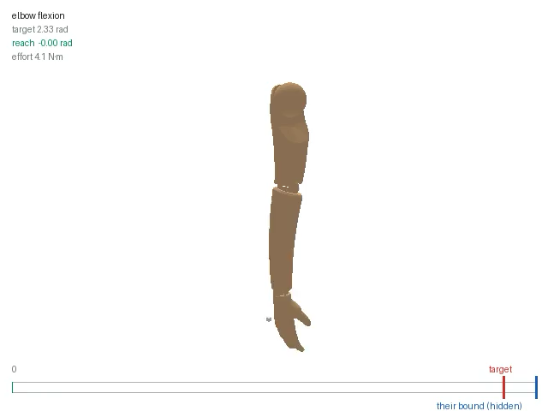
Information Gathering
Elbow flexion 1
Elbow flexion 2

Slide 16
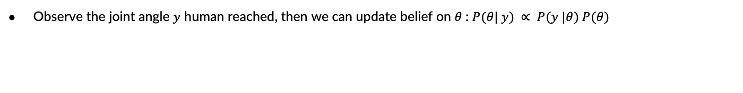
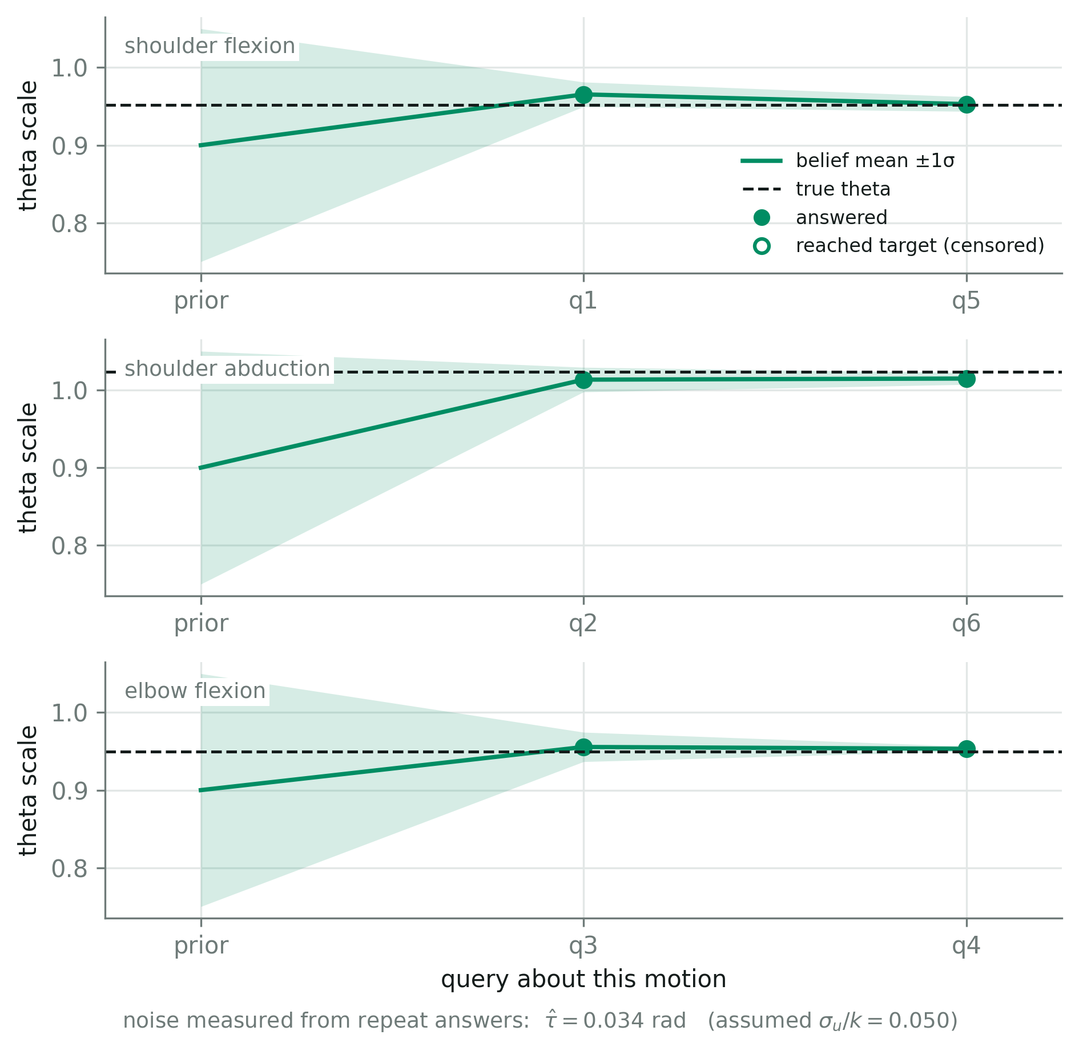
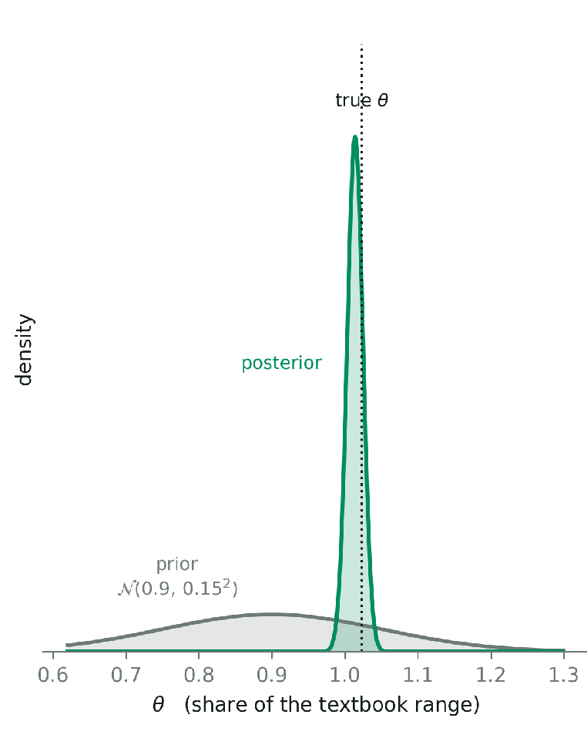

Human Model Learning
Just one dimensional bayesian update…

Slide 17
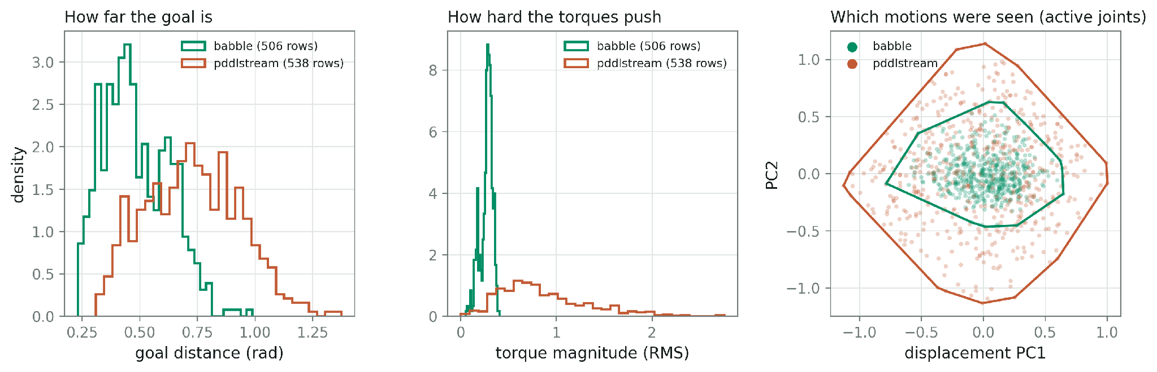
Learn to Plan Faster
200 people x 4 tasks per person
Use PDDLStream / Babble to solve these tasks
  PDDLStream: takes forever
  Babble: Apply sequences of random torque, and consider the final configuration as goal
Label: (limb_init, robot_init, limb_goal, posterior belief on RoM) -> initial control points of generated torque trajectory
Learned Models: trained simplest regressors for proof of concept (MLP, Ridge, Gradient boosting)
distance between init - goal
sqrt(mean(psi^2)) of initial mpc torque
PC1: shoulder abduction
PC2: elbow flexion

Slide 18
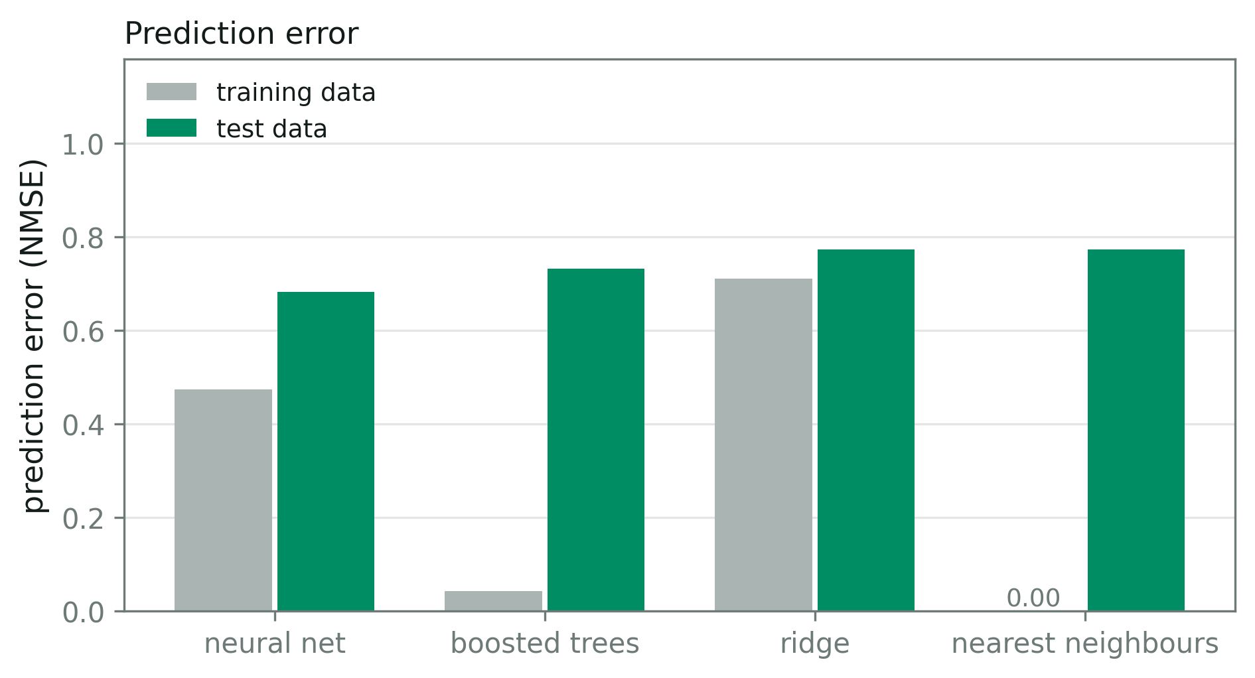
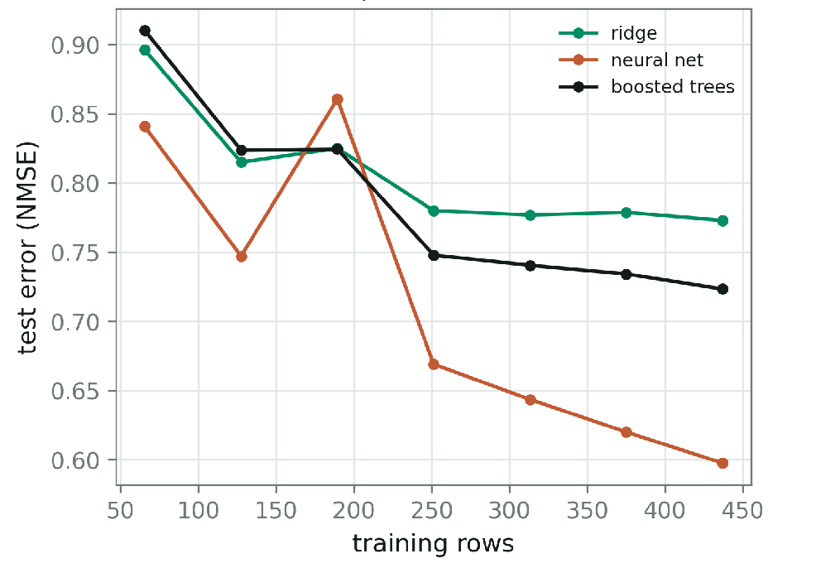
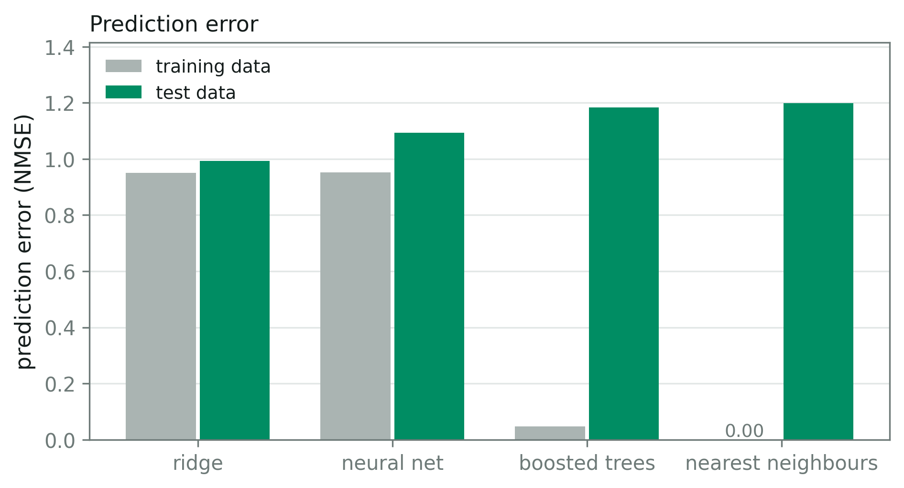
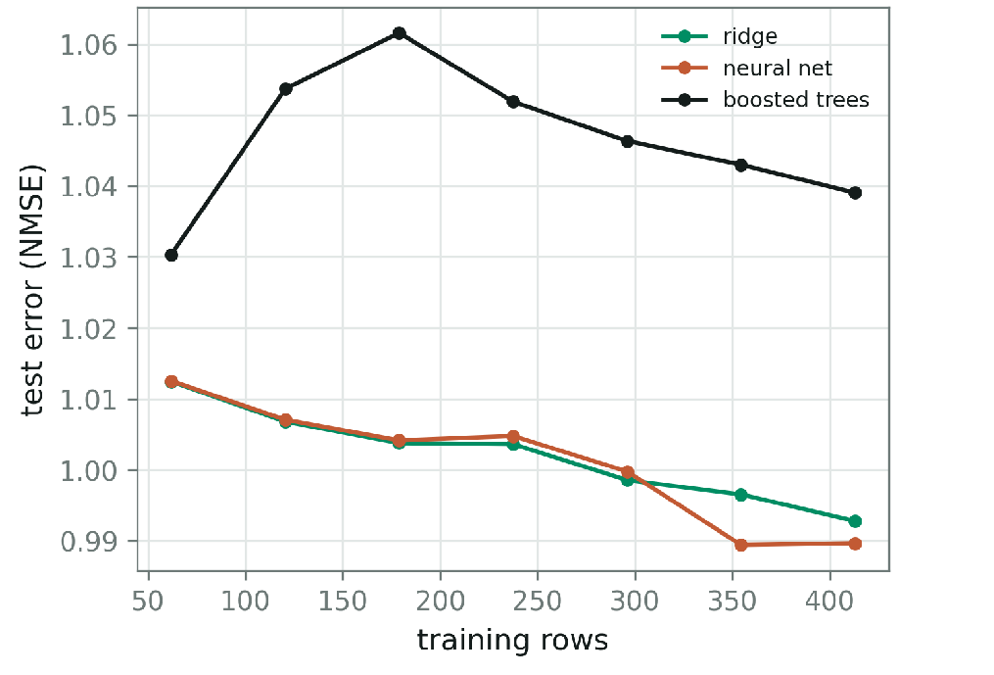
Learn to Plan Faster: Training
PDDLStream
Babble

Slide 19
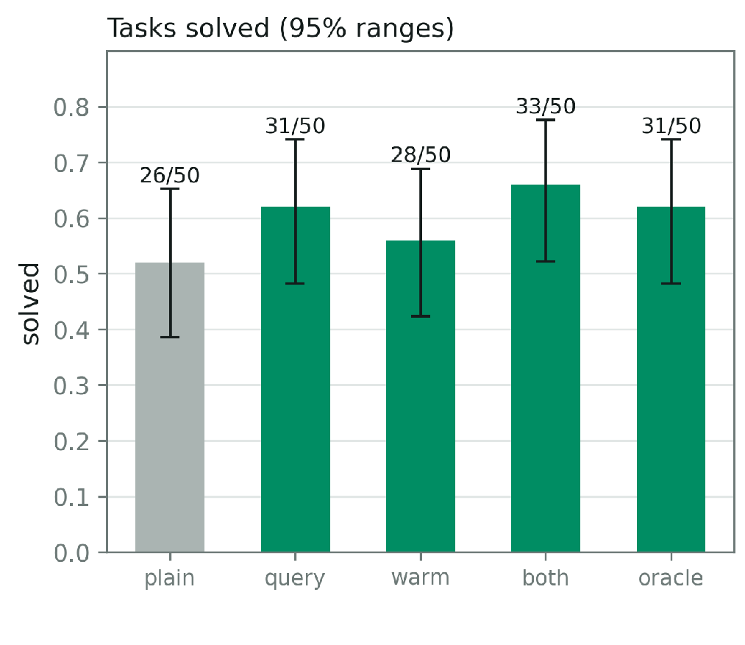
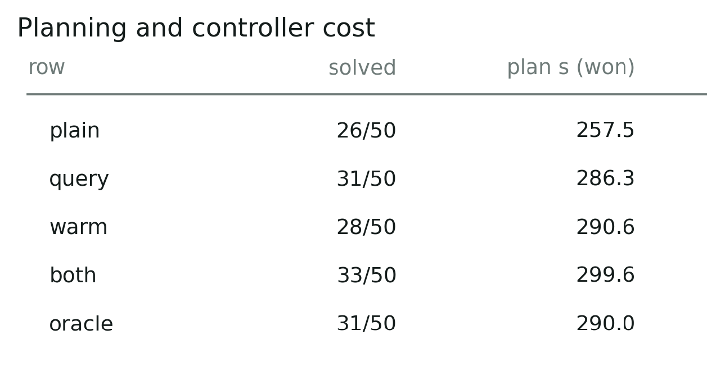
Learn to Plan Faster: Eval
plain | prior | x
query | posterior after querying | x
warm | prior | learned
both | posterior after querying | learned
oracle |  | learned
PDDLStream
SR differences could be noise, need to check with more data and model

Slide 20
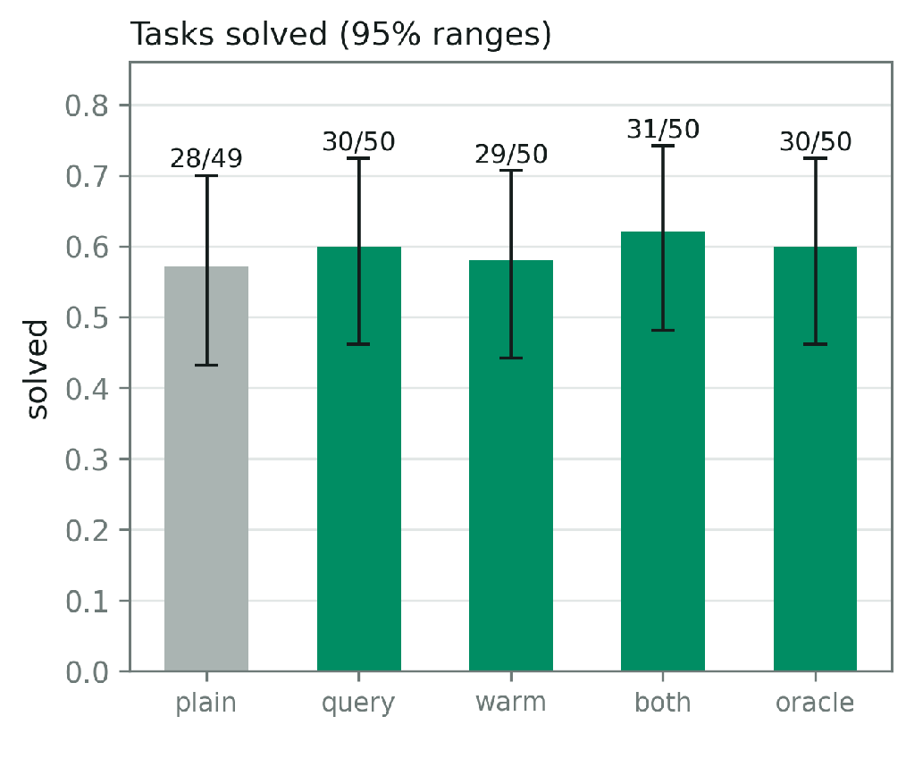
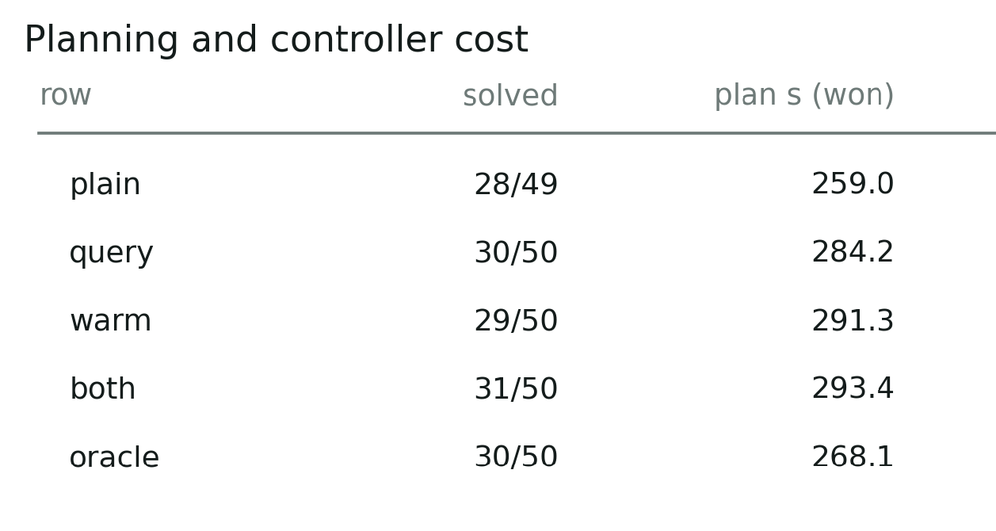
Learn to Plan Faster: Eval
plain | prior | x
query | posterior after querying | x
warm | prior | learned
both | posterior after querying | learned
oracle |  | learned
Babble

Slide 21
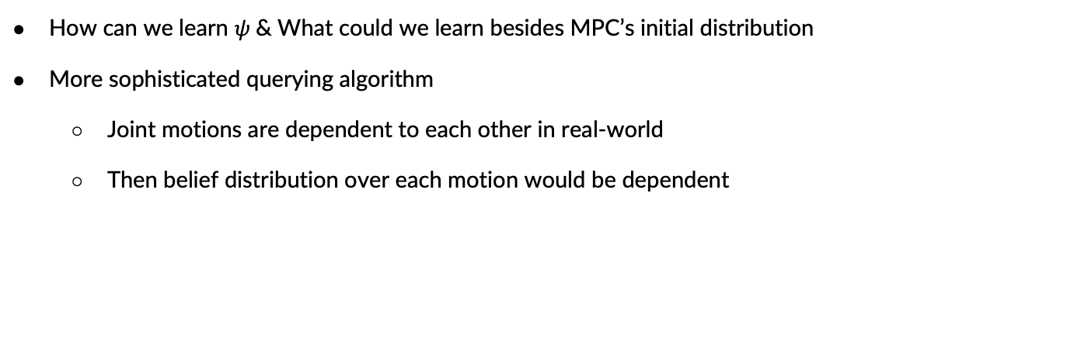
Future Directions

Slide 22
Pipeline & Formulation
Information Gathering
Human Model Learning
Learn to Plan
Planning
& Execution
Learn user’s physical parameters (RoM in this case) and adapt the planner to them

